Slide 1
React.JS
Lecture 27
Accessing REST API using Fetch

Slide 2
Implementing CRUD Operations
API Access

Slide 3
Fetch Method
Since all the data we want is stored in an API, the fetch is how we request that data.
We’re basically saying, “Hey API, here’s what I want, can you send me this data.”
The server will then respond and be like, “Sure thing, I promise to send you the data.”
We can also specify how we want the data to be returned.
JSON data is often the easiest to use, so if the server returns anything other than JSON format, if that’s what we’ve requested, we may get an error.

Slide 4
Basic Fetch
fetch(url, options).then(function(response) {
// handle HTTP response
}, function(error) {
// handle network error
})
URL: REST Link
Options: On Next Slide.

Slide 5
More Specific Request Object
fetch(url, {
method: "POST",
body: JSON.stringify(data),
headers: {
"Content-Type": "application/json"
},
credentials: "same-origin"
}).then(function(response) {
response.status //=> number 100–599
response.statusText //=> String
response.headers //=> Headers
response.url //=> String
return response.text()
}, function(error) {
error.message //=> String
})

Slide 6
Options
method (String) - HTTP request method. Default: "GET"
body (String, body types) - HTTP request body
headers (Object, Headers) - Default: {}
credentials (String) - Authentication credentials mode. Default: "omit"
"omit" - don't include authentication credentials (e.g. cookies) in the request
"same-origin" - include credentials in requests to the same site
"include" - include credentials in requests to all sites

Slide 7
Response
Response represents a HTTP response from the server.
Properties
status (number) - HTTP response code in the 100–599 range
statusText (String) - Status text as reported by the server, e.g. "Unauthorized"
ok (boolean) - True if status is HTTP 2xx
headers (Headers)
url (String)
Body methods
Each of the methods to access the response body returns a Promise that will be resolved when the associated data type is ready.
text() - yields the response text as String
json() - yields the result of JSON.parse(responseText)
blob() - yields a Blob
arrayBuffer() - yields an ArrayBuffer
formData() - yields FormData that can be forwarded to another request

Slide 8
Error
If there is a network error or another reason why the HTTP request couldn't be fulfilled, the fetch() promise will be rejected with a reference to that error.
Note that the promise won't be rejected in case of HTTP 4xx or 5xx server responses. The promise will be resolved just as it would be for HTTP 2xx. Inspect the response.status number within the resolved callback to add conditional handling of server errors to your code.
fetch(...).then(function(response) {
if (response.ok) {
return response
} else {
var error = new Error(response.statusText)
error.response = response
throw error
}
})

Slide 9
Life Cycle Hook and API Call
Generally there are two kinds of API call integration in any client side app:
When the user demands This kind of API call is requested by the user on various events like click, scroll, drag & drop etc. E.g the submission of forms and load more option. These kind of API calls has dedicated event functions and APIs are called from there.
When the component loads In many scenarios, it is required that we want to get some data as soon as the component is loaded. E.g. Consider the component which shows a list of items, in this case you need to call GET API automatically as soon as the component is loaded on the browser. Another example, can be integrating APIs for analytics on load of components.

Slide 10
We should never fetch any data in render method, as render is a pure function and calling APIs here may cause side effect.

Slide 11
ComponentDidMount
This method is the right place to integrate the API as by this time render method has been called once.
If our component is rendered on the server, the APIs will not be called twice, once because on server side componentDidMount will not be called. Hence the API will be called only once in the client.

Slide 12
Example
import React, { Component } from 'react';
class App extends Component {
constructor(props) {
super(props);
this.state = {
data: null,
};
}
componentDidMount() {
fetch('https://api.mydomain.com')
.then(response => response.json())
.then(data => this.setState({ data }));
}
...
}
export default App;

Slide 13
More Clear Example
import React, { Component } from 'react';
const API = 'https://hn.algolia.com/api/v1/search?query=';
const DEFAULT_QUERY = 'redux';
class App extends Component {
constructor(props) {
super(props);
this.state = {
hits: [], };}
componentDidMount() {
fetch(API + DEFAULT_QUERY)
.then(response => response.json())
.then(data => this.setState({ hits: data.hits }));
}
...
}
export default App;

Slide 14
render
class App extends Component {
...
render() {
const { hits } = this.state;
return (
<ul>
{hits.map(hit =>
<li key={hit.objectID}>
<a href={hit.url}>{hit.title}</a>
</li>
)}
</ul>
);
}
}
export default App;

Slide 15
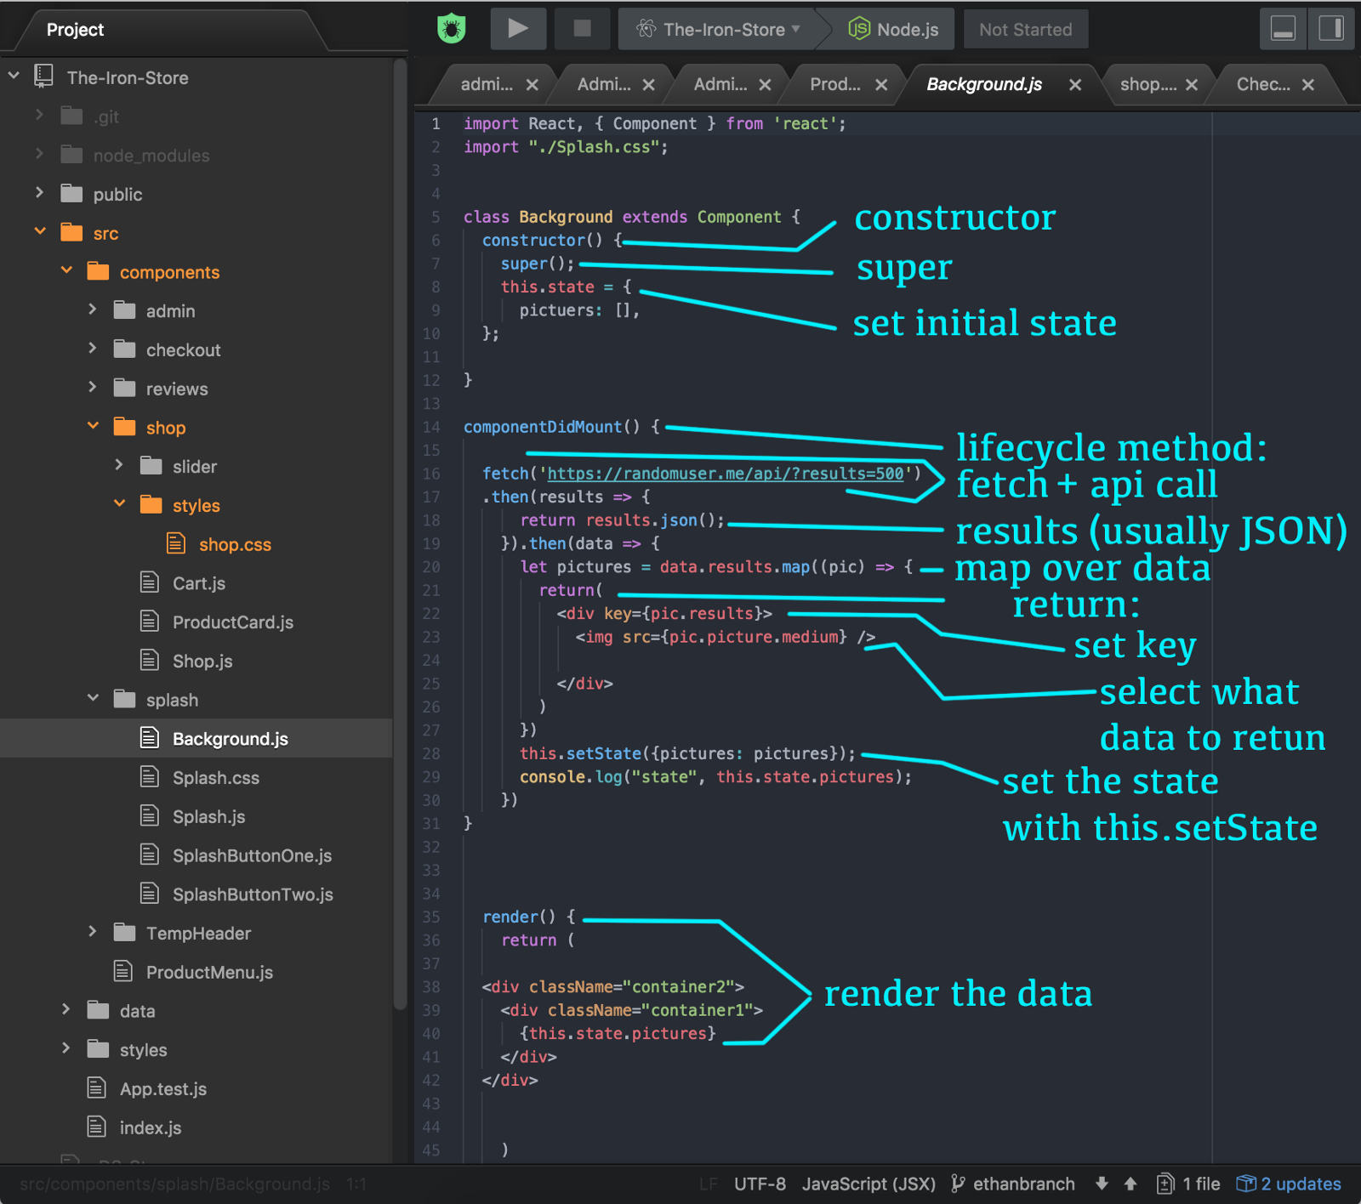

Slide 16
AWAIT and asynch
Await & asynch allows us to wait for the response of an asynchronous request.
const request = async () => {
const response = await fetch('https://api.com/values/1');
const json = await response.json();
console.log(json);
}
request();

Slide 17
Asynch other way and Try Catch
async componentDidMount() {
try {
const response = await fetch(`https://api.com/v1/ticker/?limit=10`);
if (!response.ok) {
throw Error(response.statusText);
}
const json = await response.json();
this.setState({ data: json });
} catch (error) {
console.log(error);
}
}

Slide 18
Promise.all
Wait till fulfilling all promises
function fetchProfileData() {
return Promise.all([
fetchUser(),
fetchPosts()
]).then(([user, posts]) => {
return {user, posts};
})
}

Slide 19
Suspense (Experimental)
React 16.6 added a <Suspense> component that lets you “wait” for some code to load and declaratively specify a loading state (like a spinner) while we’re waiting:
const ProfilePage = React.lazy(() => import('./ProfilePage')); // Lazy-loaded
// Show a spinner while the profile is loading
<Suspense fallback={<Spinner />}>
<ProfilePage />
</Suspense>

Slide 20
